Slide 1

Introduction & Data science platforms
資料科學 Data Science
張家銘 Jia-Ming Chang
政治大學資訊科學系
The slide is only for educational purposes. If any infringement, please contact me. We will correct immediately.

Slide 2
Copyright declaration 版權說明
Some of the figures in this presentation are taken from "An Introduction to Statistical Learning, with applications in R" (Springer, 2013) with permission from the authors: G. James, D. Witten, T. Hastie and R. Tibshirani.
The web site of the book
The credit of individual is indicated in the bottom part of the slide.
ie.,

Slide 3
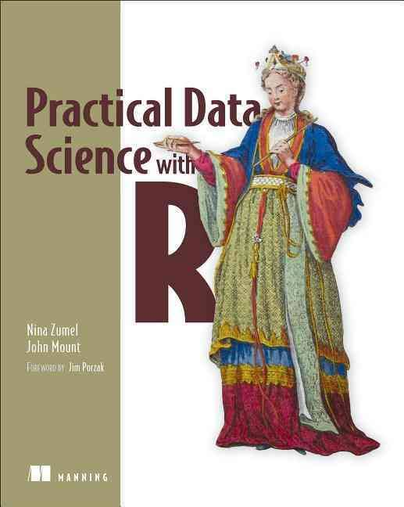
Copyright declaration 版權說明
Some of the figures in this presentation are taken from "Practical Data Science with R (Manning, 2019)”
The web site of the book
The credit of individual is indicated in the bottom part of the slide.
ie.,

Slide 4
Copyright declaration 版權說明
Some of the figures in this presentation are taken from "R for Data Science” under the Creative Commons Attribution-NonCommercial-NoDerivs 3.0 License.
The web site of the book
The credit of individual is indicated in the bottom part.
ie.,

Slide 5
What is data science?

Slide 6
Interdisciplinary
The statistician William S. Cleveland defined data science as an interdisciplinary field larger than statistics itself.
statistics
machine learning
programming / computer science
data engineering
Practical Data Science with R by Nina Zumel, John Mount

Slide 7
Data to prediction
as managing the process that can transform hypotheses and data into actionable predictions
predicting who will win an election
what products will sell well together
which loans will default
which advertisements will be clicked on
Practical Data Science with R by Nina Zumel, John Mount

Slide 8
Three components
The data scientist is responsible for
Data : acquiring the data, managing the data
Modeling: choosing the modeling technique, writing the code
Evaluation: verifying the results
Practical Data Science with R by Nina Zumel, John Mount

Slide 9

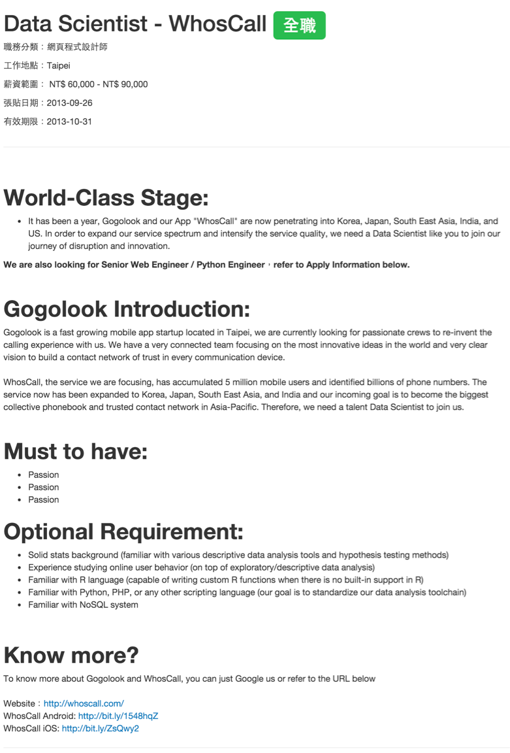
Examples @ Job market
https://www.techinasia.com/korean-web-giant-naver-acquires-taiwanese-startup-gogolook

Slide 10
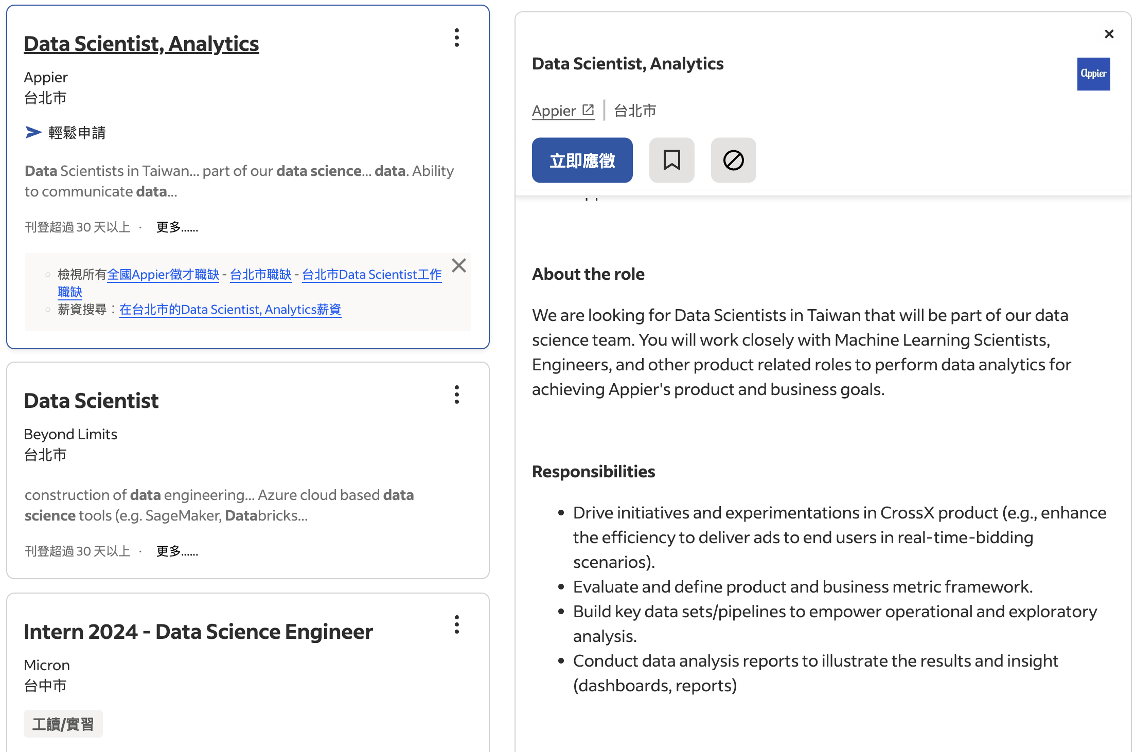
Data science is the fastest growing industry
https://tw.indeed.com/jobs?q=data+science&l=&from=searchOnHP&vjk=83a3a2c24e65e271

Slide 11
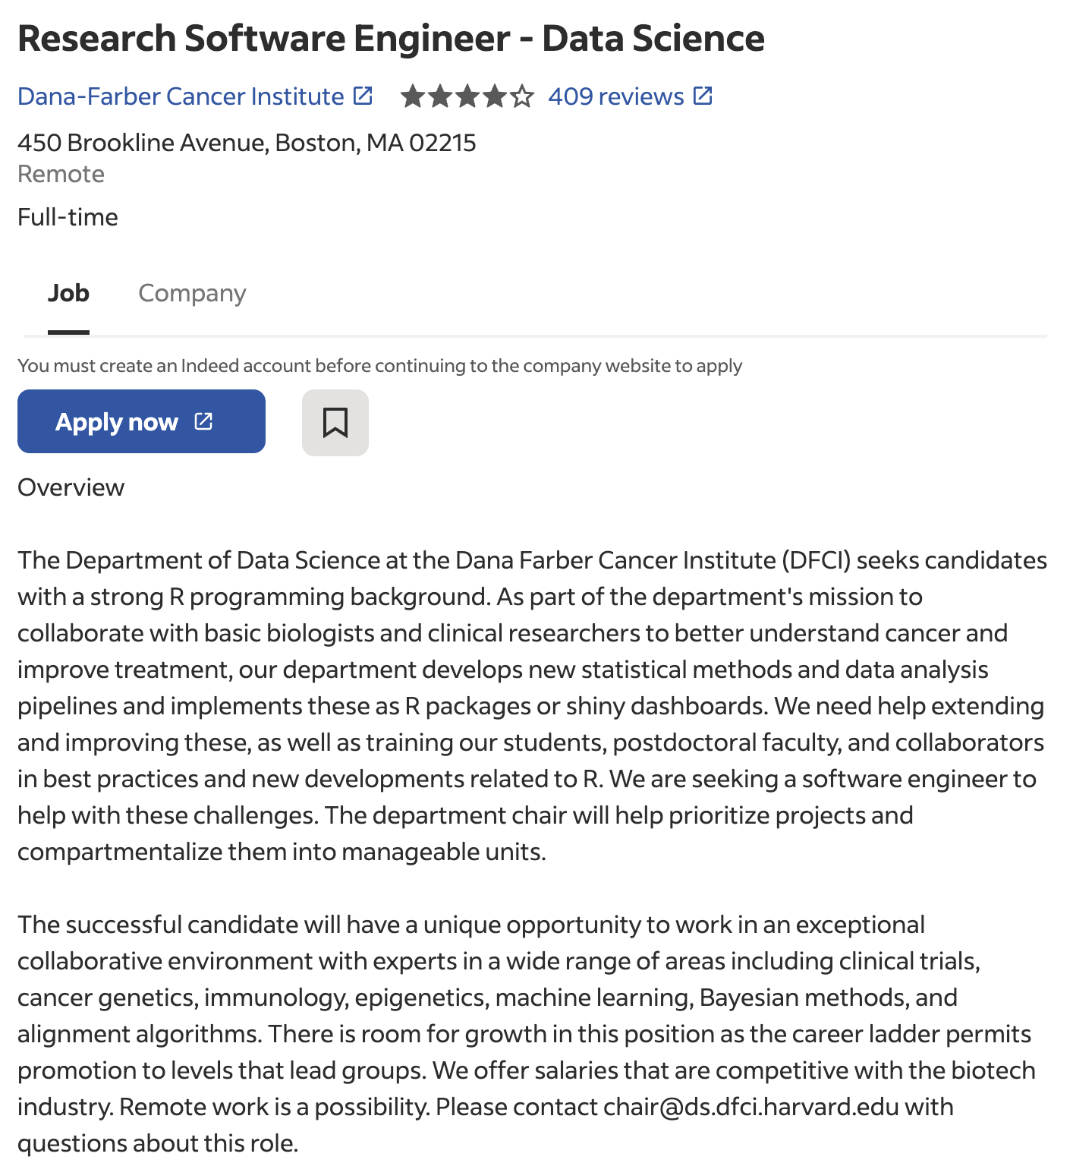
Data scientist in Bioinformatics
https://www.indeed.com/viewjob?jk=d244633e18f4d22c&tk=1hm42rdqkj210803&from=serp&vjs=3

Slide 12
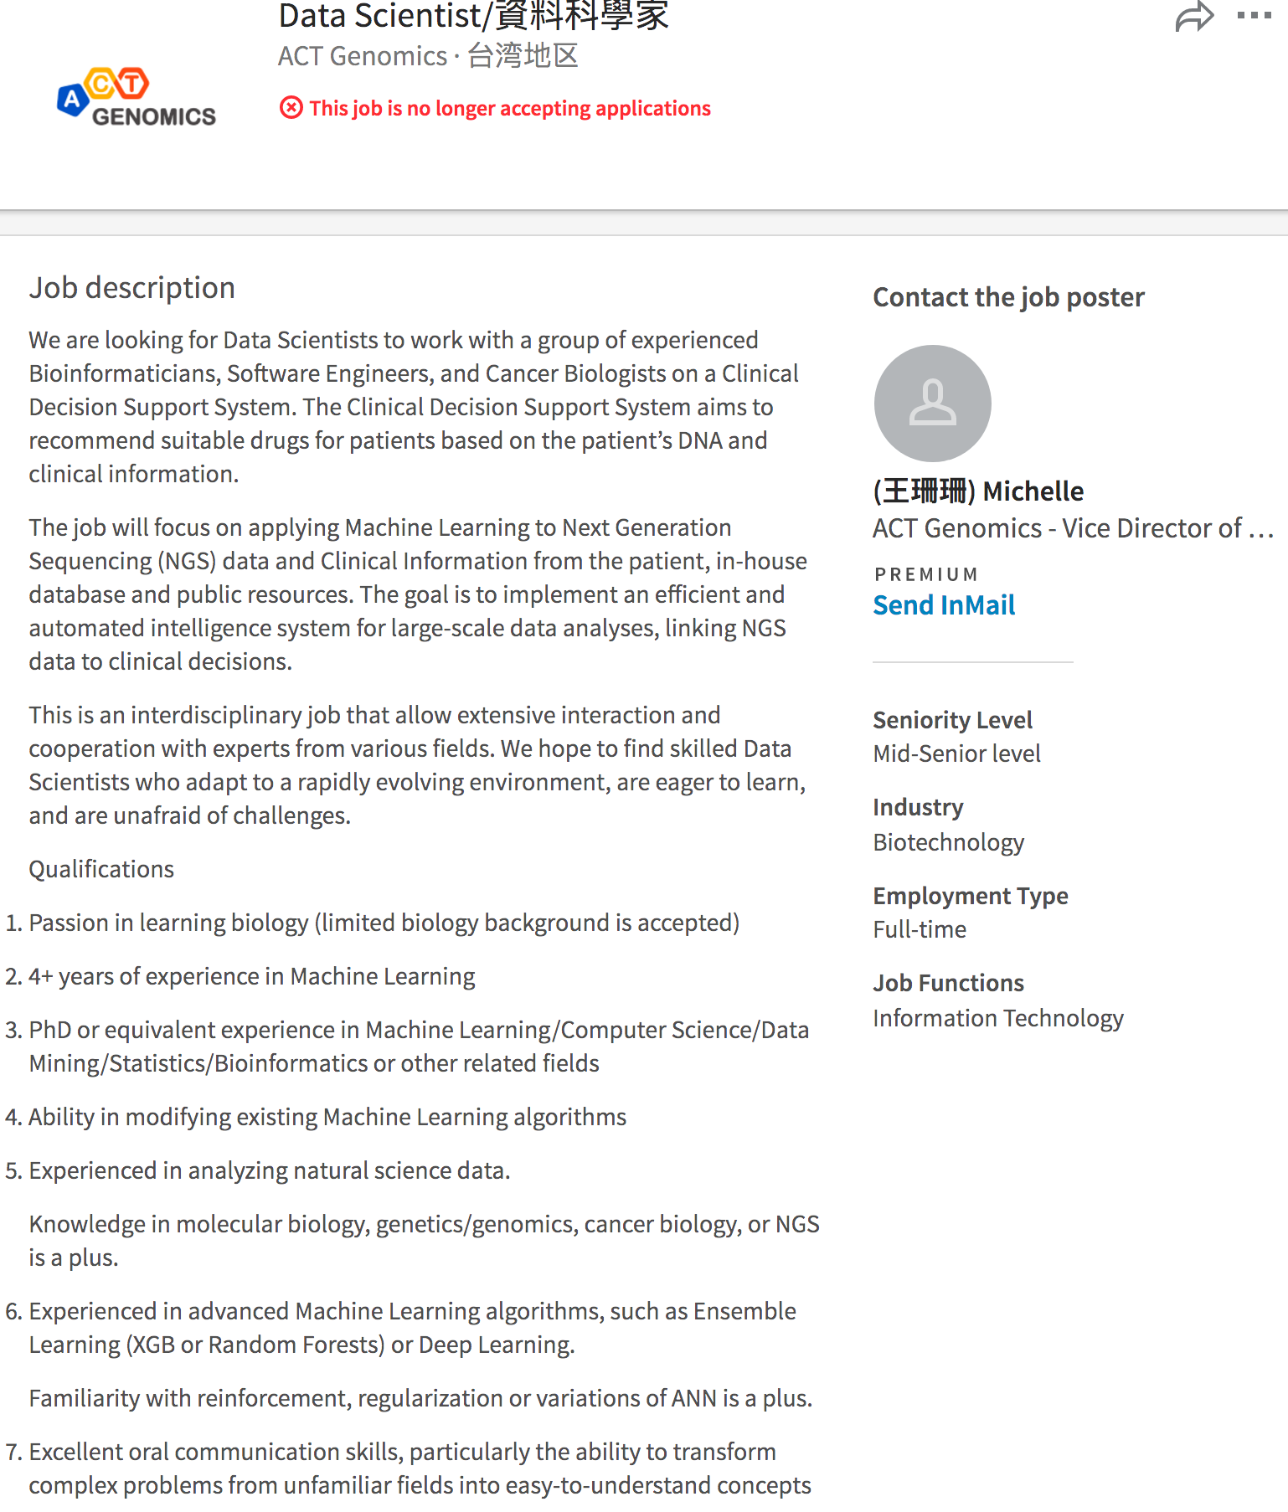
Data scientist in Bioinformatics
https://www.linkedin.com/jobs/view/370881654/?fref=gc&dti=183664932063716

Slide 13
What is R ?
a programming language and software environment for statistical computing and graphics supported by the R Foundation for Statistical Computing. R is an implementation of the S programming language. (wikipedia)
https://www.youtube.com/watch?v=XcBLEVknqvY

Slide 14
Why choose R programming language?
R's strong package ecosystem and charting benefits
https://www.datacamp.com/community/tutorials/r-or-python-for-data-analysis
Pros and Cons of R vs Python Sci-kit learn by Kaggle

Slide 15
Which is better for data analysis: R or Python?
Both R and Python are excellent choices for data analysis, and which one you choose may depend on a variety of factors, including your specific needs, preferences, and prior experience.
R is a language specifically designed for statistical computing and graphics. It has a rich set of built-in libraries for data manipulation, statistical analysis, and visualization. R's syntax is generally more concise and expressive than Python's, making it easier to perform complex data analyses with fewer lines of code.
Python, on the other hand, is a more general-purpose language that is widely used in many different fields, including data science. It has a vast ecosystem of libraries and tools for data analysis, including NumPy, Pandas, and Scikit-learn. Python is also a more versatile language than R, allowing you to perform a wide range of tasks beyond data analysis, such as web development and automation.
In summary, both R and Python are excellent choices for data analysis, and the choice ultimately depends on your specific needs and preferences. If you are interested in statistical analysis and data visualization, R may be the better choice. If you are interested in a more versatile language that can be used for a wide range of tasks, including data analysis, Python may be the better choice.

Slide 16
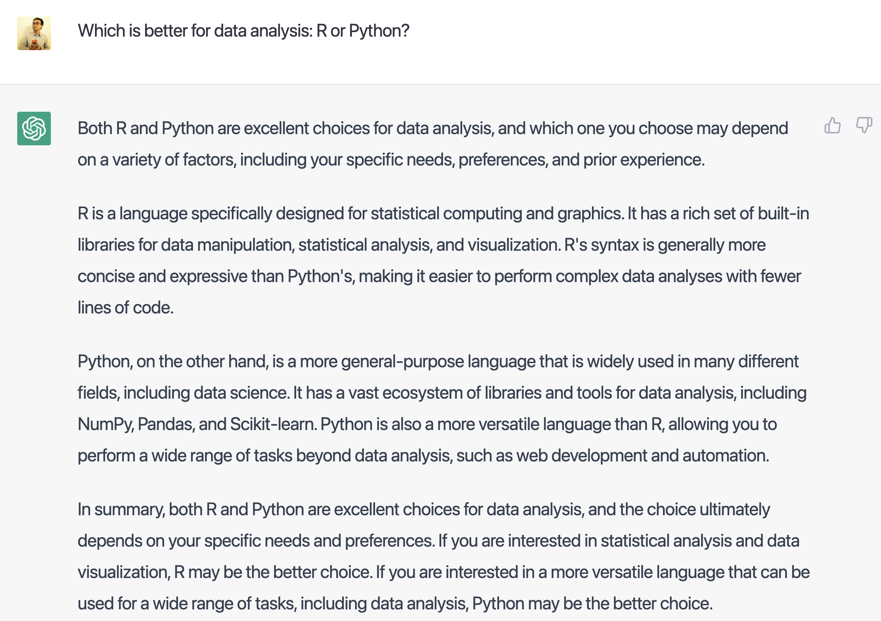

Slide 17
Data science in R is only a small subset of data science
We are mostly teaching in an R context so we have a specific simple shared platform
Most data scientists work using multiple platforms
Other platforms include:
SAS
Python (pandas, scikit-learn)
Hadoop (Mahout)
SQL analytics
Microsoft Azure
And many others
http://winvector.github.io/IntroductionToDataScience/

Slide 18
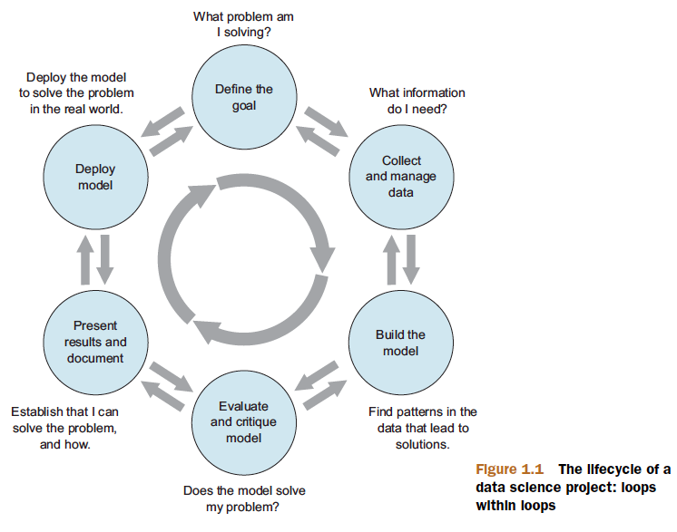
Data Science project
Find your own data set
Before midterm
Figure 1.1, Practical Data Science with R by Nina Zumel, John Mount

Slide 19
Modeling
The most common data science modeling tasks are these:
Classification—Deciding if something belongs to one category or another
Scoring—Predicting or estimating a numeric value, such as a price or probability
Ranking—Learning to order items by preferences
Clustering—Grouping items into most-similar groups
Finding relations—Finding correlations or potential causes of effects seen in the data
Characterization—Very general plotting and report generation from data
Practical Data Science with R by Nina Zumel, John Mount

Slide 20
Statistical Learning

Slide 21
Notation and Simple Matrix Algebra
n : the number of distinct data points, or observations, in our sample
p : the number of variables that are available for use in making predictions
Wage data set consists of 12 variables for 3,000 people
n=?
p=?
An Introduction to Statistical Learning with Applications in R by Gareth James, Daniela Witten, Trevor Hastie, Robert Tibshirani

Slide 22
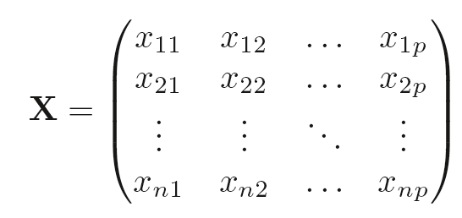
X denote a n x p matrix
An Introduction to Statistical Learning with Applications in R by Gareth James, Daniela Witten, Trevor Hastie, Robert Tibshirani

Slide 23
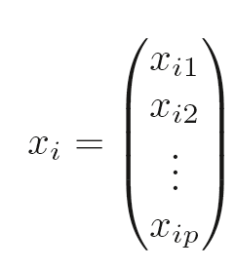
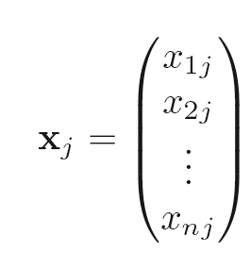
A person will be?
An Introduction to Statistical Learning with Applications in R by Gareth James, Daniela Witten, Trevor Hastie,Robert Tibshirani

Slide 24
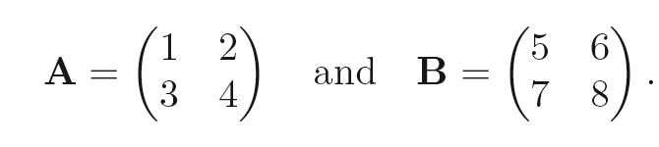
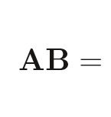
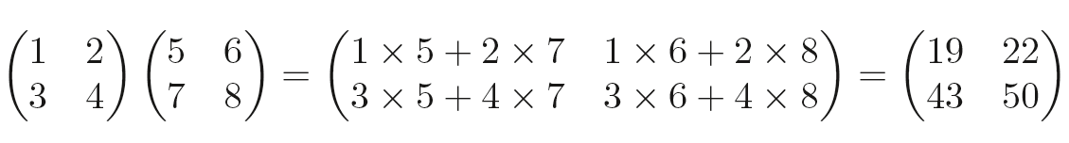
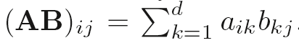
An Introduction to Statistical Learning with Applications in R by Gareth James, Daniela Witten, Trevor Hastie, Robert Tibshirani

Slide 25
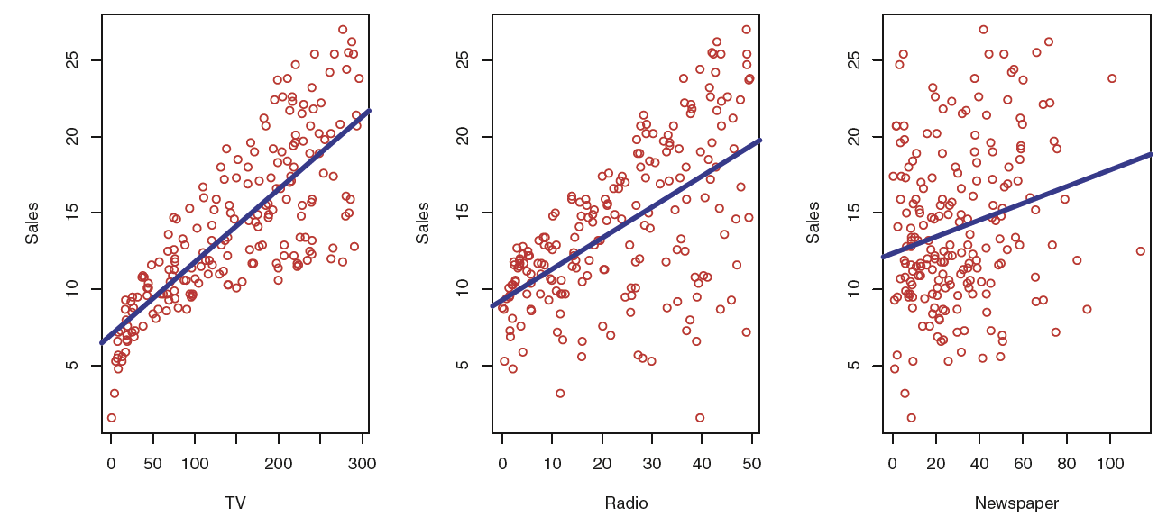
What is input? Output?
Figure 2.1, An Introduction to Statistical Learning with Applications in R by Gareth James, Daniela Witten, Trevor Hastie,Robert Tibshirani

Slide 26
The advertising data set
The plot displays sales, in thousands of units, as a function of TV, radio, and newspaper budgets, in thousands of dollars, for 200 different markets.
Figure 2.1, An Introduction to Statistical Learning with Applications in R by Gareth James, Daniela Witten, Trevor Hastie, Robert Tibshirani

Slide 27
The advertising data set
TV, radio, newspaper
predictors , independent variables , features , variable
typically denoted using the variable symbol X
Sales
response , dependent variable
typically denoted using the symbol Y
An Introduction to Statistical Learning with Applications in R by Gareth James, Daniela Witten, Trevor Hastie,Robert Tibshirani

Slide 28
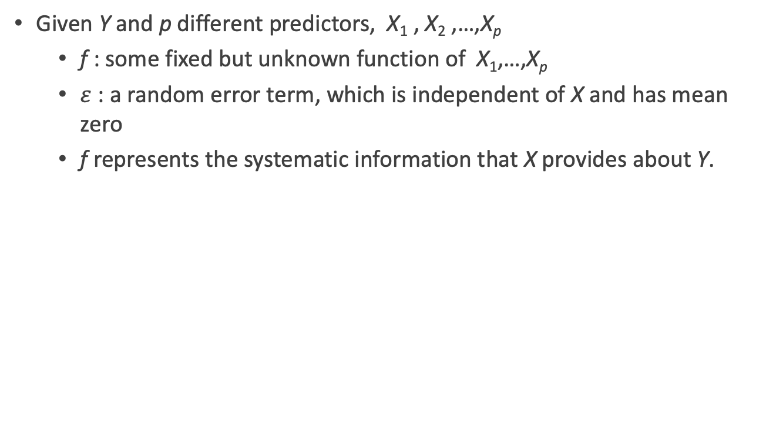
Modeling
Given Y and p different predictors, X₁ , X₂ ,…,X_{p}
f : some fixed but unknown function of X₁,…,X_{p}
$ε$ : a random error term, which is independent of X and has mean zero
f represents the systematic information that X provides about Y.
An Introduction to Statistical Learning with Applications in R by Gareth James, Daniela Witten, Trevor Hastie,Robert Tibshirani

Slide 29
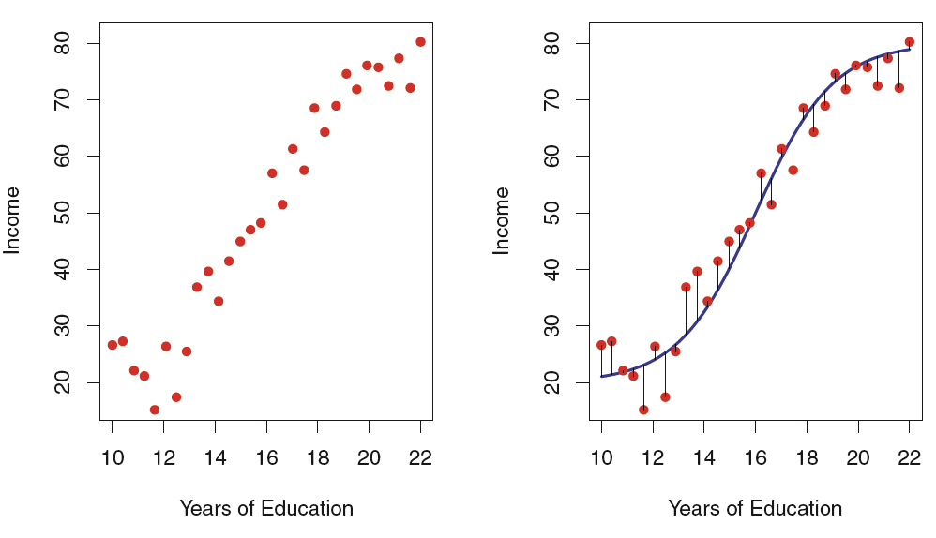
The income data set
The red dots are the observed values of income (in tens of thousands of dollars) and years of education for 30 individuals.
What is f?
overall, the errors have approximately mean zero???
Figure 2.2, An Introduction to Statistical Learning with Applications in R by Gareth James, Daniela Witten, Trevor Hastie,Robert Tibshirani

Slide 30
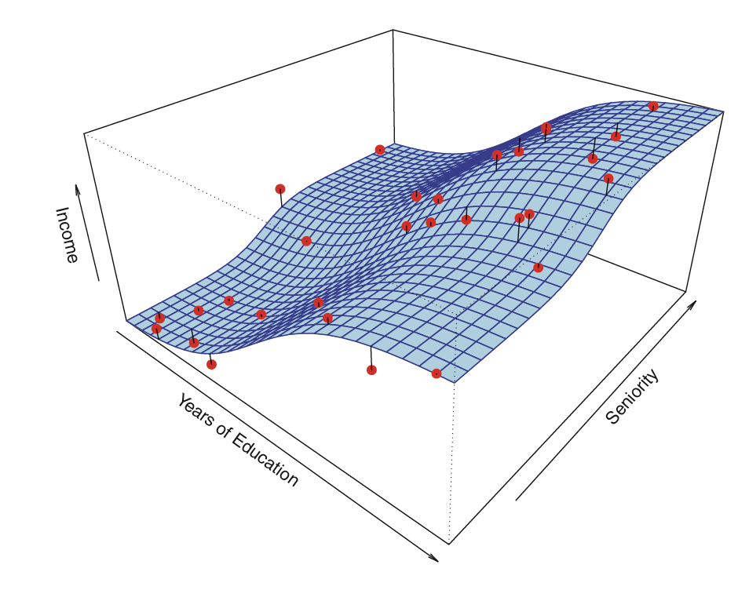
the function f may involve more than one input variable
Figure 2.3, An Introduction to Statistical Learning with Applications in R by Gareth James, Daniela Witten, Trevor Hastie,Robert Tibshirani

Slide 31
Practice Time

Slide 32
Installing R
CRAN : the comprehensive R archive network
the central repository for the most popular R libraries & serves the central role for R
A new major version of R comes out once a year, and there are 2-3 minor releases each year.
https://cloud.r-project.org
Instead use the cloud mirror, which automatically figures it out
R for Data Science by Garrett Grolemund, Hadley Wickham

Slide 33
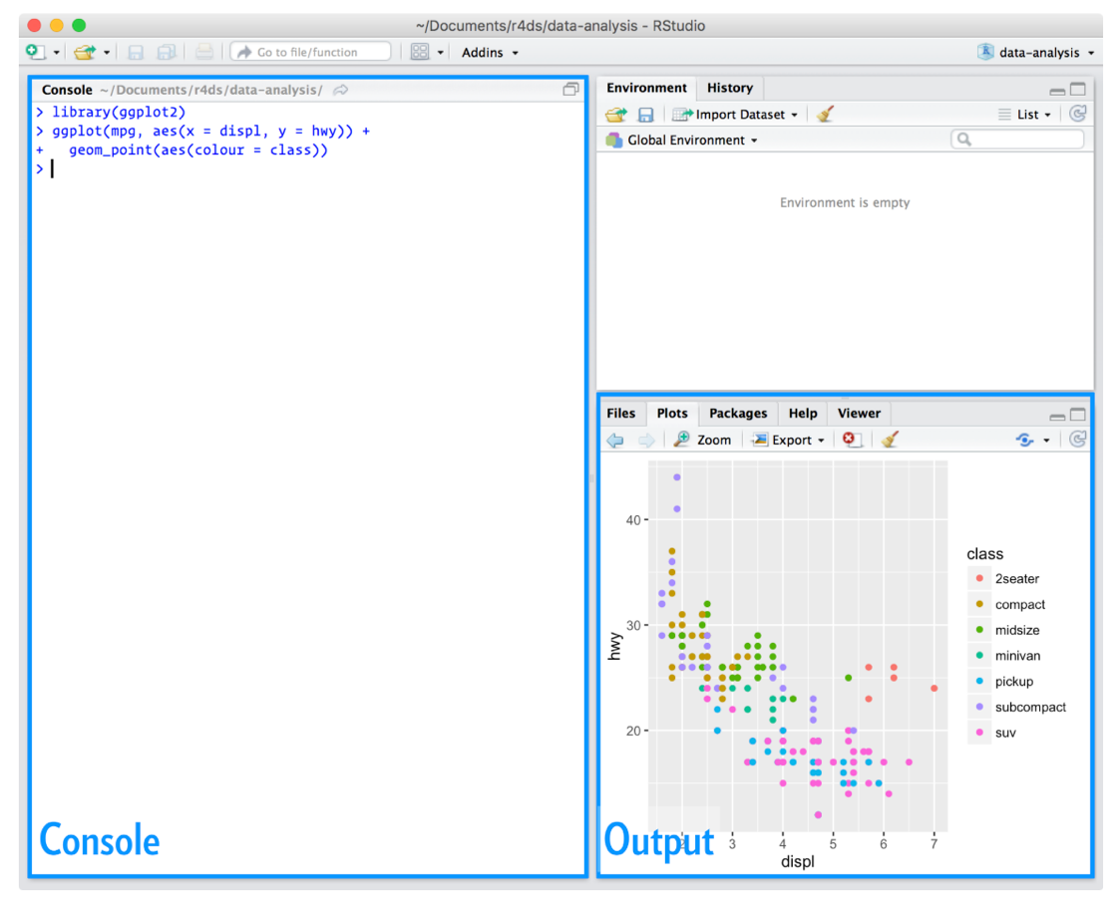
Installing RStudio
An integrated development environment, or IDE, for R programming.
https://www.rstudio.com/products/rstudio/download/
Figure 1.4.2, R for Data Science by Garrett Grolemund, Hadley Wickham

Slide 34
RStudio IDE Cheat Sheet
https://www.rstudio.com/wp-content/uploads/2016/01/rstudio-IDE-cheatsheet.pdf
The RStudio IDE is the most popular integrated development environment for R.
Do you want to write, run, and debug your own R code?
Work collaboratively on R projects with version control?
Build packages or create documents and apps?
No matter what you do with R, the RStudio IDE can help you do it faster. This cheat sheet will guide you through the most useful features of the IDE, as well as the long list of keyboard shortcuts built into the RStudio IDE. Updated 01/16.
R for Data Science by Garrett Grolemund, Hadley Wickham

Slide 35
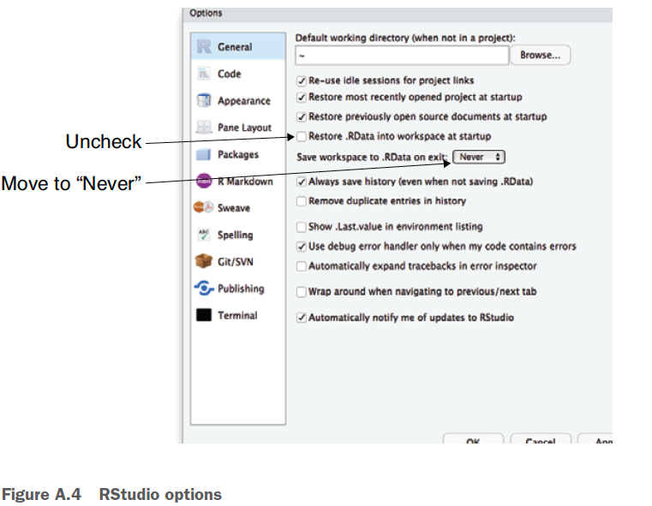
Work clean
To start with an empty workspace and explicitly bring in the packages, code, and data you want. This ensures you know how to get into your ready-to-go state (as you have to perform or write down the steps to get there) and you aren’t held hostage to state you don’t know how to restore (what we call the “no alien artifact” rule).
RStudio > Preferences, Tools > Global Options, Tools > Options
Figure A.4, Practical Data Science with R by Nina Zumel, John Mount

Slide 36
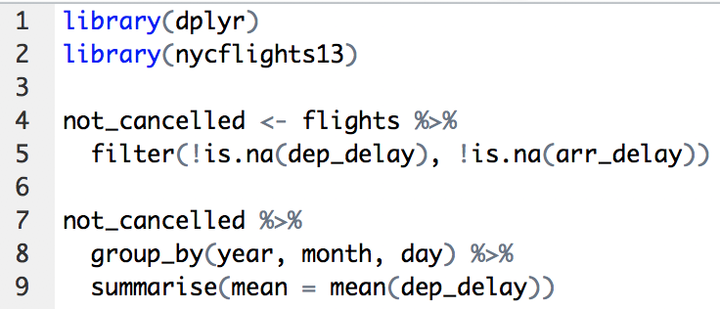
Running Code
Cmd/Ctrl + Enter : executes the current R expression in the console
runningCode.R
R for Data Science by Garrett Grolemund, Hadley Wickham

Slide 37
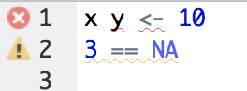
RStudio diagnostics
The script editor will also highlight syntax errors with a red squiggly line and a cross in the sidebar
diagnostics.R
R for Data Science by Garrett Grolemund, Hadley Wickham

Slide 38
Basic Commands
R uses functions to perform operations.
funcname(input1, input2)
An Introduction to Statistical Learning with Applications in R by Gareth James, Daniela Witten, Trevor Hastie,Robert Tibshirani

Slide 39
Try the help command
Start R or RStudio and type help(ls) to get
documentation on the ls command used in our example
?funcname
Practical Data Science with R by Nina Zumel, John Mount

Slide 40
Starting with R
How to use package?
install.package(’ctv’)
library(‘ctv’)
How many packages?
https://cran.r-project.org/web/views/
Practical Data Science with R by Nina Zumel, John Mount

Slide 41
Basic Commands
x <- c(1,3,2,5)
x=c(1,6,2)
y=c(1,4,3)
length(x)
length(y)
x+y
An Introduction to Statistical Learning with Applications in R by Gareth James, Daniela Witten, Trevor Hastie,Robert Tibshirani

Slide 42
Basic Commands
ls()
rm(x,y)
ls()
rm(list=ls())
An Introduction to Statistical Learning with Applications in R by Gareth James, Daniela Witten, Trevor Hastie,Robert Tibshirani

Slide 43
Basic Commands
?matrix
x=matrix(data=c(1,2,3,4) , nrow=2, ncol =2)
x=matrix(c(1,2,3,4) ,2,2)
matrix(c(1,2,3,4) ,2,2,byrow =TRUE)
sqrt(x)
x^2
An Introduction to Statistical Learning with Applications in R by Gareth James, Daniela Witten, Trevor Hastie,Robert Tibshirani

Slide 44
Basic Commands
x=rnorm(50)
y=x+rnorm(50, mean=50, sd=.1)
cor(x,y)
An Introduction to Statistical Learning with Applications in R by Gareth James, Daniela Witten, Trevor Hastie,Robert Tibshirani

Slide 45
Basic Commands
set.seed(1303)
rnorm(50)
An Introduction to Statistical Learning with Applications in R by Gareth James, Daniela Witten, Trevor Hastie,Robert Tibshirani

Slide 46
Basic Commands
set.seed (3)
y=rnorm (100)
mean(y)
var(y)
sqrt(var(y))
sd(y)
An Introduction to Statistical Learning with Applications in R by Gareth James, Daniela Witten, Trevor Hastie,Robert Tibshirani

Slide 47
sessionInfo()
what packages are present in your session
Very information for reproducing your analysis
=> keep essential information when writing paper
Practical Data Science with R by Nina Zumel, John Mount

Slide 48
R語言翻轉教室
http://datascienceandr.org/
By Wush Wu、Chih Cheng Liang、Johnson Hsieh

Slide 49
References
https://twitter.com/rstudiotips
RStudio Tips twitter account
find one tip that looks interesting. Practice using it!
https://support.rstudio.com/hc/en-us/articles/205753617-Code-Diagnostics
What other common mistakes will RStudio diagnostics report?
R for Data Science by Garrett Grolemund, Hadley Wickham

Slide 50
Getting help and learning more
If you get stuck, start with Google. Typically adding “R” to a query is enough to restrict it to relevant results
If Google doesn’t help, try stackoverflow. Start by spending a little time searching for an existing answer, including [R] restrict your search to questions and answers that use R.
R for Data Science by Garrett Grolemund, Hadley Wickham

Slide 51
Getting help and learning more
If you get stuck, start with Google. Typically adding “R” to a query is enough to restrict it to relevant results
If Google doesn’t help, try stackoverflow. Start by spending a little time searching for an existing answer, including [R] restrict your search to questions and answers that use R.
R for Data Science by Garrett Grolemund, Hadley Wickham

Slide 52
Webs
Stack Overflow R section : A Q&A site: http://stackoverflow.com/questions/tagged/r
LearnR : A translation of all the plots from Lattice: Multivariate Data Visualization with R (Use R!) (by D. Sarker; Springer, 2008) into ggplot2: http://learnr.wordpress.com
R-bloggers : A high-quality R blog aggregator: http://www.r-bloggers.com
Courses http://dataology.blogspot.tw/
R programming
Norman Matloff, The Art of R Programming
Garrett Grolemund, Hands-On Programming with R
R plus statistics
Robert Kabacoff R in Action (2nd edition) Quick-R http://www.statmethods.net/
Jared P. Lander R for Everyone
Data Science
Cathy O’Neil, Rachel Schutt Doing Data Science
Nina Zumel, John Mount Practical Data Science with R
Machine Learning
James et. al. An Introduction to Statistical Learning
Haste et. al. The Elements of Statistical Learning
Free ebooks @ http://dataology.blogspot.tw/2015/09/60.html
http://winvector.github.io/IntroductionToDataScience/

Slide 53


Thank You Any Question?

